Slide 1
Cyclops– Vocabulary and Dataset Creation
Joanne Yoon, Anurag Bejju, Alex El-Hajj, Denise Chen, Saeid Molladavoudi, Nick Denis, Monica Pickard
February 03, 2020

Slide 2
Word/ Char Vocabulary - Embedding's
0
<UNK> - Any word not present in this 5575749 dictionary
(1 – 31318)
31317 – Words common in training and pre trained embedding.
These words are mapped to a 200 dimension vector
[ Primary ]
(31319 –
163412)
126093– Words found in training but not in pre trained
embedding. These words are termed as OOV
[ Primary ]
(163412 –
5575750)
5412338 – Words found in pre trained embedding but not in
training set. These words are mapped to a 200
dimension vector
[ Secondary]
137 – Unique Characters

Slide 3
Word Embedding Initialization
<token>
Search
Found: return (1,200)
Found: return (1,200)
Found: Random ini (1,200)
Not Found: Search
Return <UNK>
Not Found
Not Found: Search
(163412 –
5575750)
0
(1 – 31318)
(31319 –
163412)
[ Primary ]
[ Secondary]
[ Primary ]

Slide 4
Kind of dictionaries present
Primary Word Dictionary
pd_ind_to_word_dictionary
pd_word_to_ind_dictionary
pd_ind_to_word_embd_dictionary
pd_word_to_word_embd_dictionary
Secondary Word Dictionary
sd_ind_to_word_dictionary
sd_word_to_ind_dictionary
sd_ind_to_word_embd_dictionary
sd_word_to_word_embd_dictionary
Pretrained Primary Word Dictionary
pre_pd_ind_to_word_dictionary
pre_pd_ind_to_word_embd_dictionary
pre_pd_word_to_word_embd_dictionary
Char Dictionary
char_index
index_char
OOV Primary Word Dictionary
oov_pd_ind_to_word_dictionary
oov_pd_word_to_ind_dictionary

Slide 5
Train and Test set
Used stratified sampling method where we have equal distribution of 8 classes in both training and test set
70 %
156,375 records
30%
67018 records

Slide 6
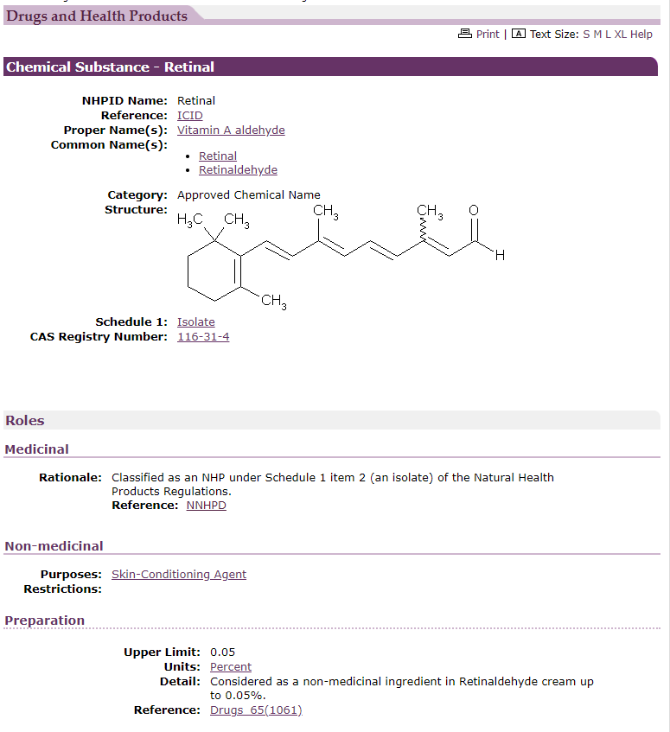
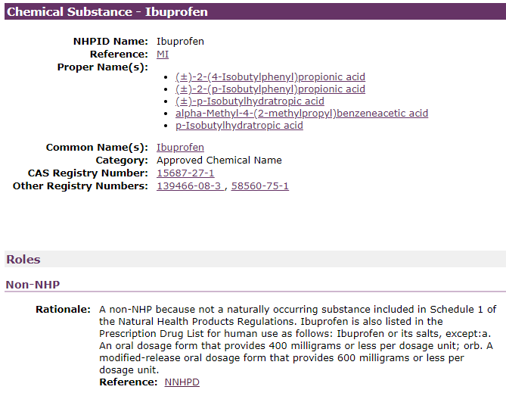
Alias names

Slide 7
Model Training Approach
Datasets:
NHP {Medicinal Ingredients, non-med ingred., Claims, Risk, Dosage, Company Name, NPN, …} Train/Dev/Test
Inputs = sentences/single words with all the same per word label
Annotated OCR
Annotation issues?
Graph IE to produce “graph” inputs
Inputs = multi-lines/sentences/single words with varied word labels for a given input
OCR has spelling mistakes
This is the format inputs will be ‘in-the-wild’
Synthetic data
Create synthetic multi-lines from NHP dataset by concatenated random inputs together.
Train model with spelling mistakes (direct OCR output)
Consistency regularization

Slide 8
Ingredient roles
Medicinal
Nonmedicinal
Components?
Homeopathic?
Non NHP

Slide 9
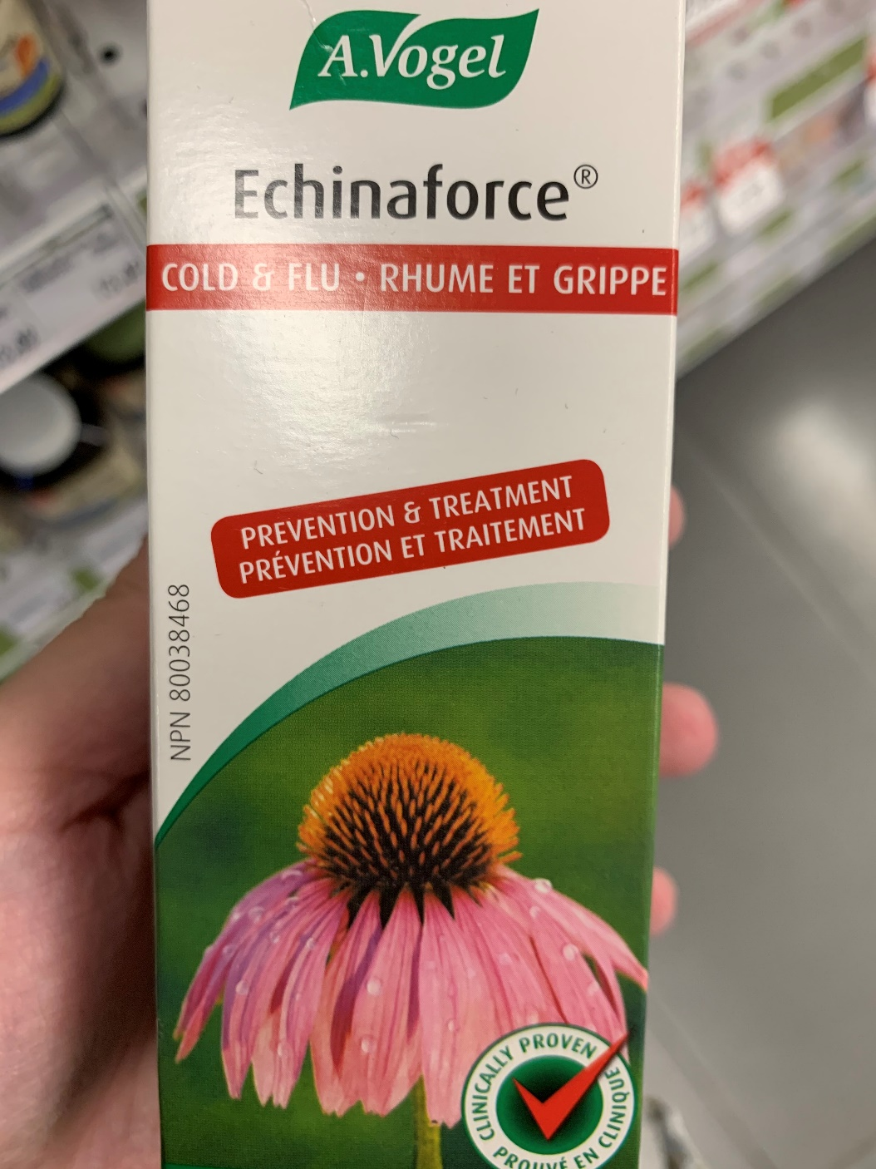
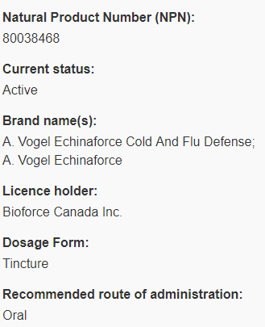
Why search for NPN?
IMAGE
DATABASE
It is the key to search for compliancy.
Assumption: Most of time, they will match. Otherwise, minor difference.
Assumption: The image with the NPN contains product name at least

Slide 10



How to find THE NPN
Find exact NPN match
If multiple candidates, consider the following….
In all cases, we must follow the assumption that product name in DB is similar to the image with NPN.
On FRONT page
Next to NPN word
On BACK page
NOT nearby NPN word
Obvious Pick!

Slide 11
Thank You /
Je vous remercie

Slide 12
Timelines
Train word classifier (late February)
Base w/ NHP dataset
Base w/ NHP + annotated OCR images datasets
Base w/ NHP + annotated OCR images + synthetic instances datasets
Fine-tuning
Finalize OCR spell checking (mid February)
Optimize Graph IE approach (mid/late February)
Proposals (mid March)
NPN (mid February)
Medicinal Ingredients
Company Name
Product Name
Claims
Compliance Assessment (March 31st)
API calls and logic
Report
Web App

